Slide 1
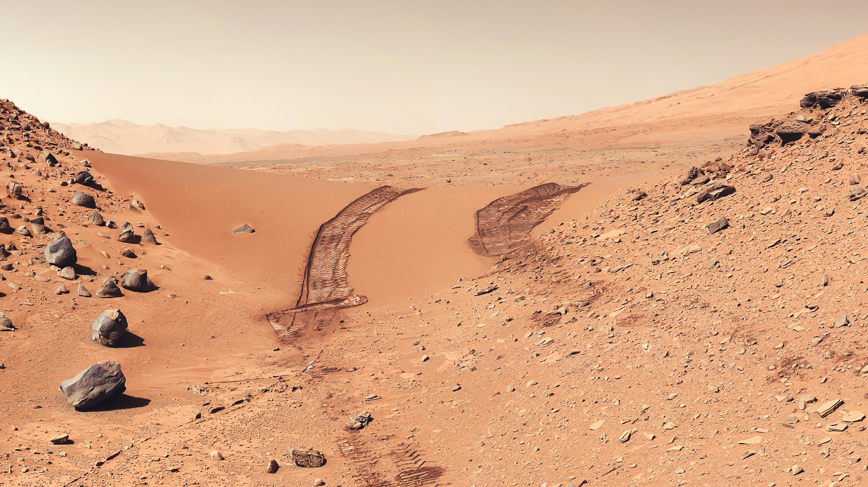
Mars Rover Imitation Learning
By Brian Xu and Hairuo Sun

Slide 2
Motivation
Large parts of Martian terrain haven’t been explored
Several past rover missions were concluded due to trapped rovers
Mapping FreeSpace + Obstacle Detection = Improved Rover Safety
Stixel World
Imitation Learning

Slide 3


Background Material
Udacity Mars Rover Simulator
2016 Navigation Challenge for NASA
Unity 3D
Miniconda environment
Socket.io + Flask for communications
Homework 1 : Imitation Learning
Similar Imitation Learning Procedures

Slide 4
Methods
Imitation Learning Procedure
Creating Expert Data
Actions, Observations
Actions = (steering -angle, throttle, brake)
Observations = Front camera image
Saving Expert Data
Rover properties → Robot_Log.csv
(Rover.img, Rover.throttle, etc.)

Slide 5
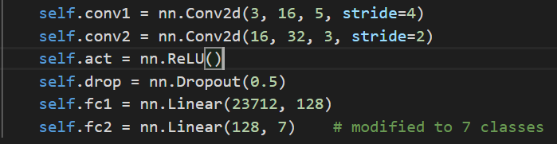
Methods
Imitation Learning Procedure
Loading Expert Data
Pandas for CSV → Array
Pillow for JPEG → Array
Training Neural Network
Simple Architecture:
Parameters:
Epochs: 150, Batch_Size: 64
Optimizer: Adam, Learning Rate: 1e-5 (very low)
Loss: Cross Entropy

Slide 6
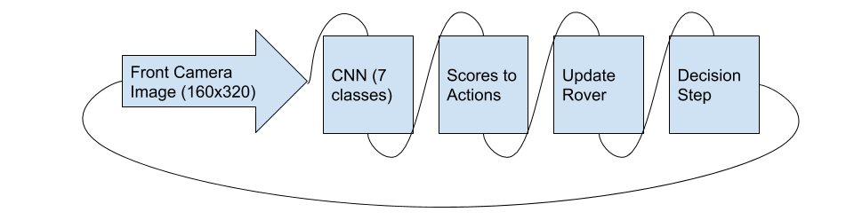
Methods
Imitation Learning Procedure
Actions to Classes
Given some combination of input, determine state
One-Hot Encoded classes
Scores to Actions
Given probability of class, return corresponding action commands
Max probability
Sample data pipeline:

Slide 7
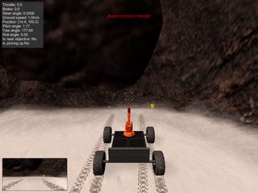
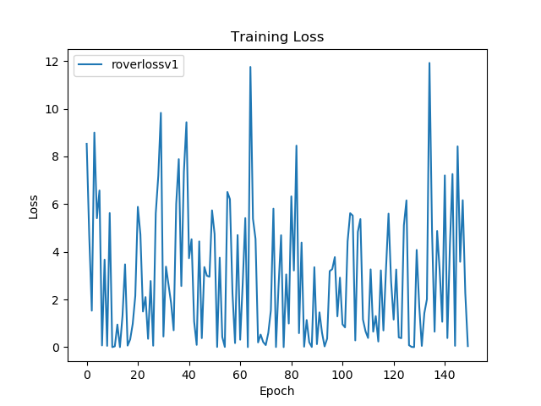
Results - Initial Model
Data Size: 2534 Images and Actions
Loss Plot: Doe not stabilize, starts at an irregularly low value. Learning failed.
Sample Output: Rover just bumps into walls, not safe traversal at all

Slide 8
Optimizations
Data Reductions
Sometimes rover only does one specific action due to ‘flooding’ of data
Cut proportion of specified class to balance data
Simplifying Training Goal
Safe Traversal is too universal of a goal to train for, Split up goal into different Modules
Follow Wall/Path
Avoid Obstacles
Changing Input Image
Front camera not optimal for some scenarios (misclassification of rocks and background wall)

Slide 9
Optimizations
Training Methods + Techniques
Rover keeps bumping into any objects even though it detects the object/wall
Reduce amount of throttling while recording imitations
Keep speed below 2.0 mph
Introduce new class called Keep (no action)

Slide 10
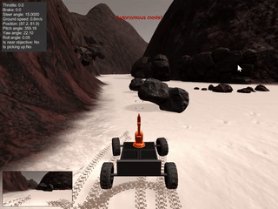
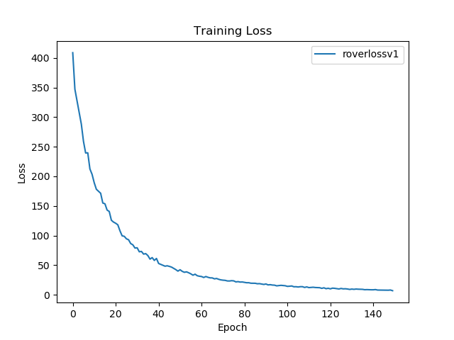
Results - Obstacle Detection
Dataset Size : 2171 Images and Actions
Training: Avoid walls and rocks
Loss Plot: Loss stabilizes ~10 to 20. Minimal spiking and converges at a reasonable rate.
Sample Output: Rover turns right when rock reaches proximity

Slide 11
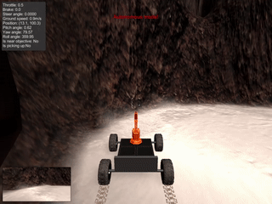
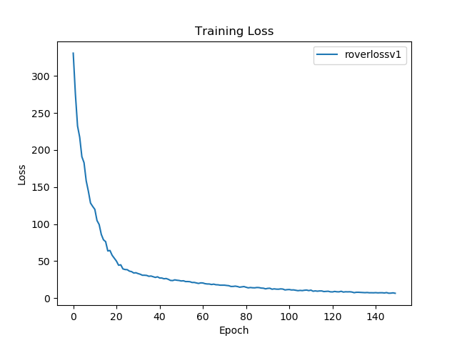
Results - Path Following
Data Size: 2572 Images and Actions
Keep vs Throttle: Balance of the two
Loss Plot: Very Stable, no irregularities, converges at around 5.0 to 10.0
Sample Output: Rover follows wall, straightens properly, will ‘catch’ walls if in front camera image

Slide 12
Results - Combined
Data Size: 4742 Images and Actions
Combined Images and actions of both models
Rover LOST functionality
Does not detect obstacles
Does not follow wall
Gets stuck on brake and keep classes
Possible Mistakes
Data balance is different between two different classes
Modularizing was successful, recombination is not as simple

Slide 13
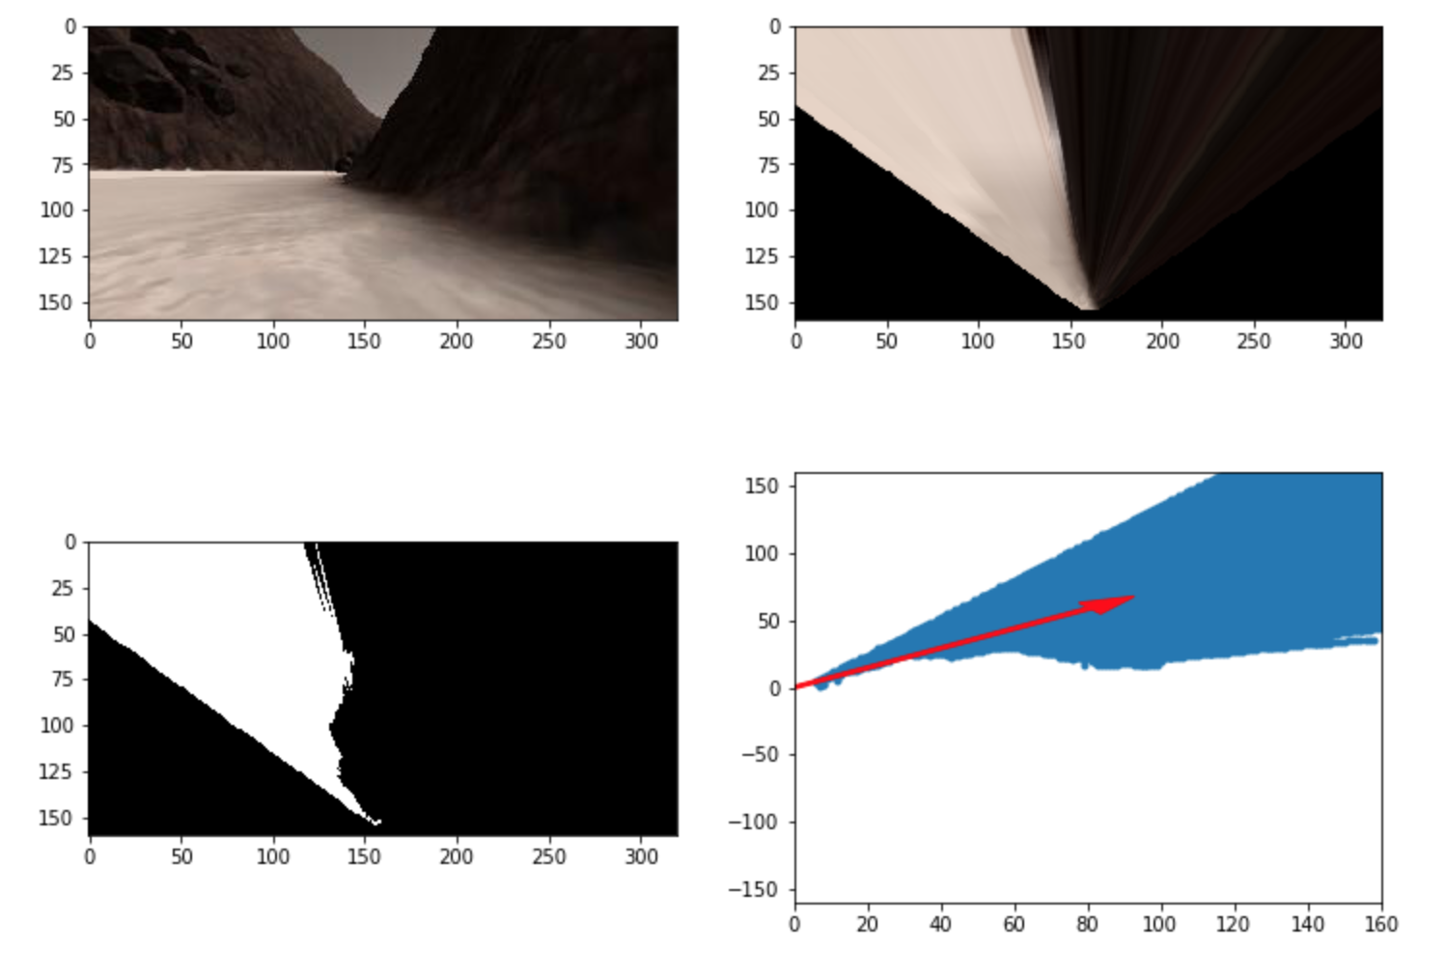
Optimization - Perspective Transforms + Color Thresholding

Slide 14
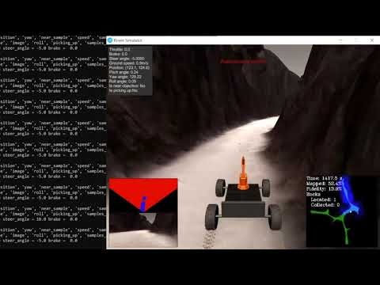
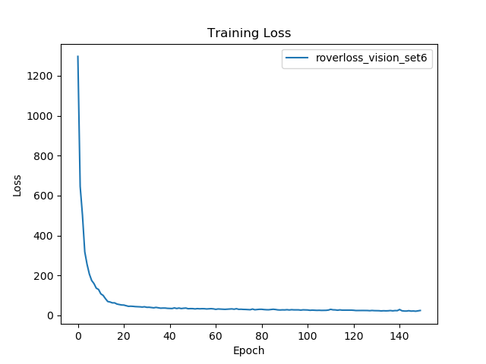
Results - Top Down + Free Space
Sample Output: (Original trained route)
Rover follows Right wall
Good Performance.
Constant Steering Adjustment.
Data Size: 1374 Images and Actions, lr = 1e-4
Training: 1) Balance Throttle_left, Throttle_right, Throttle & Keep. 2) No Brake, Left, Right. Slow Speed.
Loss Plot: Stabilize at around 13

Slide 15
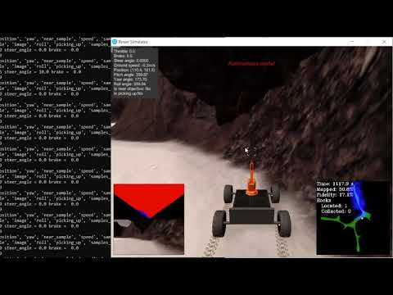
Results - Top Down + Free Space
Sample Output:
(New route)
Rover follows Right wall
Good Performance.
Constant Steering Adjustment.
Smalle Issue:
Get stuck because and hit right wall (because it cannot distinguish between the wall obstructions & actual dead end sometimes)
Remedy: Rover did try to turn left, but not very successful.

Slide 16
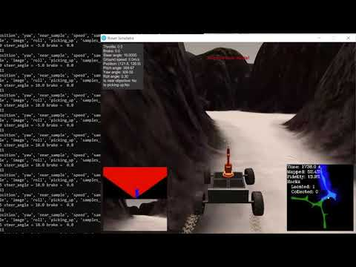
Results - Top Down + Free Space
Sample Output:
(Original trained route)
Rover follows Left wall
Mediocre Performance.
Need Manual Interference to help rover get unstuck.
Issue:
Rover keep a closer distance to the left wall.
Rover cannot distinguish between the actual dead end of a route and the left/right wall obstruction (vision image - mostly red pixels)

Slide 17
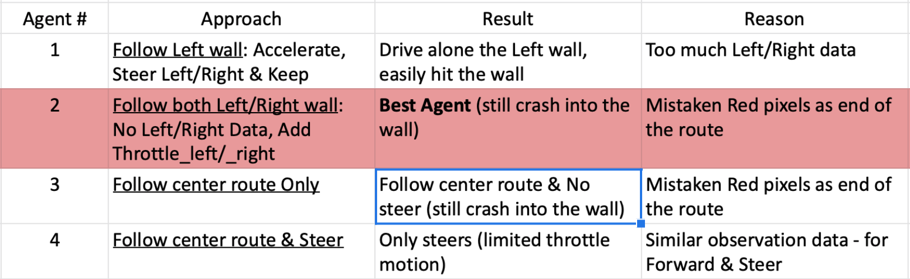
Results - Top Down + Free Space
Trained Agents - Approach & Result

Slide 18
Conclusion
Front Camera
Modularization - Successful
Simplifying Task drastically improved performance
Data Reduction/Balancing - Successful
Balance of data proves to be crucial in successful expert data
Recombination of modules - Unsuccessful
Upon recombination of two datasets, introduce new problems
Differing balances between tasks

Slide 19
Conclusion
Vision Image
Rover follows Right wall & steering - Successful
Agent generalizes driving scenarios well for both original training route & new testing routes.
Performs well with less data
Combine acceleration and steering left/right in one action
Rover follows Left Wall - Need human interference
Ageners performs badly with only steering left/right when encountering wall obstructions
Agent has a hard time distinguishing between side walls’ obstructions and the end of the route

Slide 20
Future Works
Implement Stereo Camera + Stixel World
Due to time constraints, and learning requirement of project, could not get to implementing Stixel world implementation
Prevent misclassification of wall and obstacles / the end of the route to avoid crashing into the wall.
Try alternative learning method
Planned alternative was Reinforcement Learning
Combine Modular Pipeline + Imitation learning
Have states for rover to be in
I.e. Avoiding obstacle, Following path
Use different weights depending on state

Slide 21
Reading Questions
Just kidding.

Slide 22
Thank you!

